Slide 1

CONSCIOUS UNCOUPLING
Innovative ways to separate user habits from user needs

Slide 2

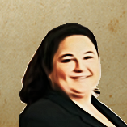
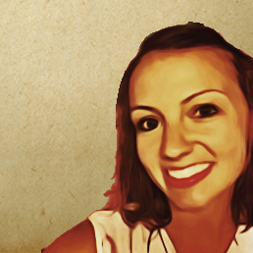
INTRODUCTIONS
KRISTEN LOHMAN
UX designer
NATALIE KURZ
JESSICA MARINE
UX designer
Product owner

Slide 3
TABLE OF CONTENTS
01
UNITED STATES TAX COURT (USTC)
Building a new case management system
02
HOW HABITS BECOME DOGMA
Avoiding the “That’s the way we’ve always done it” trap
03
BARRIERS TO CHANGE
What we have here is a failure to communicate
04
HOW TO OVERCOME
Tactics for change

Slide 4
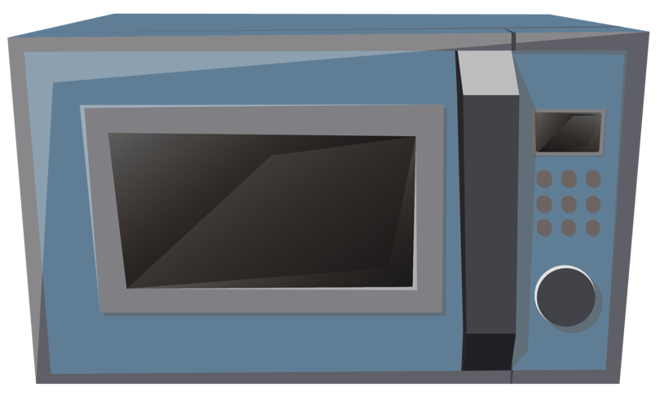
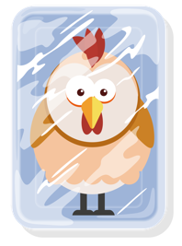
Example 1: An analogy for UX research
REQUIREMENT
What’s the best way to thaw frozen chicken?
Notes:
This story is my secret weapon to get clients to understand UX research

Slide 5
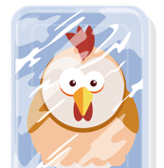

Example 1: An analogy for UX research continued
REALLY…
What’s the best way to thaw frozen chicken…without the cat eating it?
Notes:
This story is my secret weapon to get clients to understand UX research

Slide 6
UNITES STATES TAX COURT (USTC)
01
Building a new case management system

Slide 7
HISTORY
The United States Tax Court is the primary federal court that resolves issues between taxpayers and the IRS.
30-35 JUDGES
35+ YEARS
Who work at the Tax Court in Washington D.C.
Age of Court’s current legacy case management system
73 CITIES
11.5 YEARS
Judges travel nationwide to provide access to the Court for all
Average length of service for 166 current Court employees
70%
2017
Taxpayers who represent themselves, so everything has to be very user-friendly
Put out competitive procurement to build new open-source system
Notes:
Build a green field case management system where to receive, track, and manage petitions to the United States Tax Court contesting federal taxes.
Involved doc management, scheduling trials, reporting, tracking cases, in-system communication, etc.
166 – Current # of employees
11.5 years – Average length of service
Length of Service -- # of Employees
5 years or less -- 61
6 to 10 years -- 28
11 to 15 years -- 31
16 to 20 years -- 14
21 to 25 years -- 8
26 to 30 years -- 7
31 to 35 years -- 13
36 to 37 years -- 4

Slide 8
SYSTEM OVERVIEW
Build a green field case management system to receive, track, and manage petitions to the United States Tax Court contesting federal taxes.
COMMUNICATION
TRIALS
Send messages, add notes to cases, receive notifications
Schedule trials across different cities, assign cases to trials, track status
CASE MANAGEMENT
REPORTING
Work case through its entire lifecycle
Standard reports run frequently, on-demand and customized reporting
DOC MANAGEMENT
ROLE-BASED ACCESS
Scan paper, edit data, print docs, e-sign, maintain versions, etc.
Permission-based views generated by user roles, sealed cases
CREATE DOCUMENTS
AUTOMATION
Write, edit, and issue orders, share access to certain docs, save draft
Digitize and automate manual or paper processes
Notes:
Here’s what the new system had to do

Slide 9
CHALLENGES
In addition to the usual challenges of building complex software, we faced other unique obstacles.
COULDN’T SEE SYSTEM
DISCONNECTED APPS
Strict NDA meant we couldn’t see a single piece of the existing system — no screens, no data
New features were rolled out as a separate system/app that didn’t talk to the existing ones
SYSTEM OWNERSHIP
COMPLEX WORKFLOWS
Many employees helped in the creation of the existing system over years of use
The system has over a dozen user types with different permissions, needs, and tasks
LONG-TIME USERS
OFFLINE PROCESSES
Many users have been on the system for 20+ years and aren’t very tech savvy
Cases were only initiated with a paper petition and many complicated processes were offline
Notes:
The main challenges we faced with rebuilding a system

Slide 10
HOW HABITS BECOME DOGMA
02
Avoiding the “that’s how we’ve always done it” trap

Slide 11
WORKAROUNDS & TRADITIONS
PROMPTED BY SYSTEM LIMITATIONS
01
Misunderstood user needs, long turnaround times, and technical constraints made workarounds necessary
WORKAROUNDS
DRIVEN BY INSTITUTIONAL KNOWLEDGE SILOS
Solve the immediate problem without removing the obstacle
02
As long as it gets done, the challenges are not shared across the organization
CONTINUES THROUGH TRAINING
03
Antiquated processes are passed down to new employees who don’t understand their origin
Notes:
Picture it, it’s the 1980’s and there’s a new case management in town using the latest technology. It’s new, it’s exciting.
Over time, system limitations become apparent though, and users create homegrown solutions to help them get their jobs done while they eagerly await updates to the application. Because waterfall-based methodology takes time, these workarounds became more and more ingrained in the internal rhetoric of employees.
When the next generation of users were onboarded, they’re trained using these workarounds and the cycle continues
Workarounds due to system or organization limitations become habits and traditions in the workplace
Employees who create processes to overcome these limitations are empowered and proud of their innovation (rightfully so)
These workaround processes are then passed down to each new employee and make their way around the organization. New employees or people in other areas of the organization have little to no context around why the this is the way something is done, they just know that this is how it’s done.
USTC had many examples of convoluted processes that had been so ingrained in them over the years, they became a sort of dogma. This is the way we do it. We couldn’t possibly do it any other way.

Slide 12
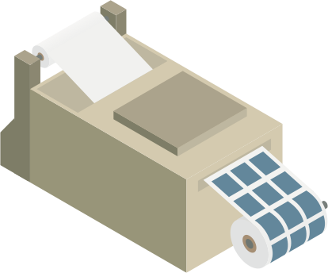
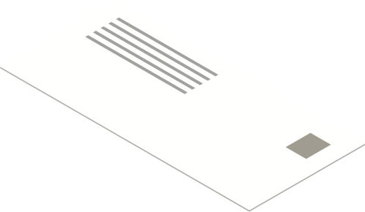
Example 1: printing addresses
REQUIREMENT
System needs to integrate with label makers
Notes:
While watching user process a case, I noticed she was printing labels to mail docs to petitioners
So we discussed “oh yeah, I guess the new system needs to integrate with the label makers.” - and they need to be able to create a label at any point within the process - wasn’t presented as a problem or concern or even a “how can we do this better?” Just a realization for a new requirement
Continued interview, but it was nagging at me - so I later followed up with “why do you print labels in the first place?”
Well, they have non-windowed envelopes so they got everyone label printers so they didn’t have to write all the addresses by hand
At the time, they were solving the problem of “how can we not write all these things down?” as opposed to “how can we make this mailing process more efficient?”

Slide 13

Example 1: printing addresses continued
REALLY…
Able to mail documents to petitioners
Notes:
But here’s an opportunity to reframe the question - her end goal wasn’t to actually print labels. It was to quickly mail things.
Requirement - print labels to mail documents
Actually - mail documents
Remove constraint of having to print labels = lots of ways to mail
Solution - switch to window envelopes and be able to print an address sheet from the system at any time (no new equipment to buy or integrate with)

Slide 14


Example 2: assigning case numbers
REQUIREMENT
Assign online petitions case numbers based on pre-numbered folders
Notes:
Example 2 - File clerks - assign case number based on mail date and physical folders
Current state - only receive petitions by mail, so they prenumber sequential folders and cases get assigned numbers and added to folders as they were processed. Because different people are doing this simultaneously they needed to prevent duplication, which is why they used pre-numbered folders
Change - now there are also digital case numbers AND manual ones from mailed in petitions

Slide 15

Example 2: assigning case numbers continued
REALLY…
Assign sequential case #s from both online and paper petitions
Notes:
Example 2 - File clerks - assign case number based on mail date and physical folders
Challenge - how do you synch up digital case assignment numbers with the pre-numbered folders?
Requirement - keep case numbers in sequential order from when they were received when numbers are assigned BOTH digitally and manually on pre-numbered folders
Actually - keep all case numbers in sequential order from when they were received (regardless of paper or digital)
Remove constraint of folders being pre-numbered or treating mailed petitions differently
Solution - have all case numbers assigned digitally, then add that case number to folders as needed

Slide 16
OUR JOB AS RESEARCHERS
Uncover the REAL problem and see where we can remove artificial constraints
Notes:
Take the cat out of the equation
BUT that doesn’t address the barriers that you face when trying to overhaul tightly ingrained processes

Slide 17
BARRIERS TO CHANGE AT USTC
03
What we have here is a failure to communicate

Slide 18
JARGON
Language originating from antiquated process
Notes:
Challenge 1 - Jargon
Every industry has its own jargon, and it’s a challenge we anticipate when we begin to learn about users
On top of legal jargon we had to learn, there were dozens of terms and phrases that had special meaning to Court users
Why jargon is such a challenge
Part of their everyday vocabulary but completely foreign to us
Conflicts with our own mental models as researchers - even we make assumptions
Prevents us from quickly getting to a common starting point - if we’re not on the same page

Slide 19
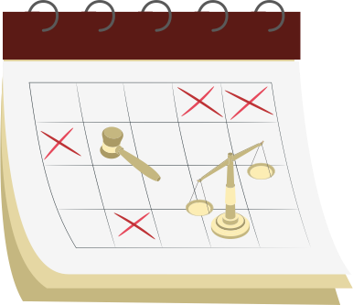
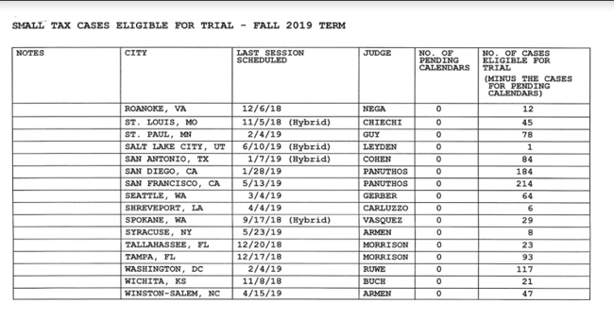
EXAMPLE – WHAT’S A CALENDAR?
To Court users, Calendar was a process where they’d print out dozens of reports and manually determine where to have trial sessions based on complex criteria.
US
COURT USERS
Notes:
Example from USTC:
What is a Calendar?
We discovered a big difference between how we and the Court understood some of the terminology
When we heard “Calendar”, we assumed that meant the type of calendar we are all familiar with, the graphical representation of a day, month or year.
To them, it was a process:
Had to visit every city once a year
Only went to cities when there were enough eligible cases to try
Determined dates for trials in each city per quarter (looked at events in that city during that time - not going to schedule New Orleans during Mardi Gras)
Assigned judges to that city - didn’t let the same person go to Hawaii every year, looked
Took them WEEKS to do
Then they had to go into the system and manually assign each actual case to that trial session
And as trial session approached, they manually reviewed each case again to see if it was still eligible for trial or had been settled (closed)

Slide 20
SILOS
Reluctant to share all they know
Notes:
Challenge 2 - Organizational Silos
Disparate system modules - different users literally used different applications to view the same information
Each group knows only their narrow slice of a larger, complex cross-functional workflow

Slide 21
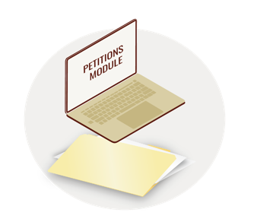

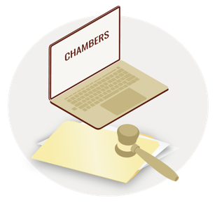
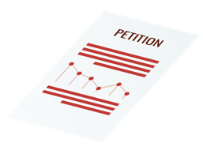

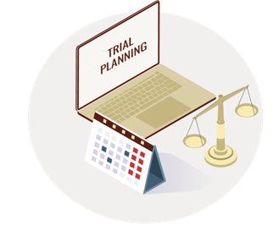
EXAMPLE - CASE LIFECYCLE PROCESS
Employees were experts at their jobs and super users of the legacy system – but very few people could give you a comprehensive view of the entire process.
Notes:
The case lifecycle process at USTC was intentionally siloed.
A case begins with a petition submitted to the Petitions section, where they enter data into a specific module.
After the Petitions section is done with their tasks, the case is handled by the Docket Section, who receive document filings to a separate inbox, and perform other, very specific tasks through a set of distinct screens. Most of the information overlaps with what Petitions may have dealt with, but now new case status, new process, new UI.
Separately from Petitions and Docket is what the Judges had access to, a module called Chambers, another specific set of screens with duplicative information.
In addition, there is also a program for Calendar to schedule cases for trial.
The Calendar program was fed by another offline system for Trial Session Planning, completely separate from the core case management system but essential for the case lifecycle.
This only accounts for a fraction of the silos, both organizational and technological, that existed.
When doing early discovery and walking through the case lifecycle with a mixed group of users, not only were users unsure of what other departments did, they sometimes disagreed about how things were done….

Slide 22
FEAR OF CHANGE
Job security; ownership of processes
Notes:
Challenge 3 - Fear of Change
Been doing things the same way for decades
Pride in the process - users who created the original system or the workarounds that saved the day have a feeling of ownership
Efficiencies in processes and technology could replace them

Slide 23
EXAMPLE – RESISTING CHANGE
Our attempts to automate a process failed because Court employees were so used to the existing workaround, they didn’t think it needed improvement.
What are your digits?
Notes:
Example from USTC: The “Digits”
Docket clerks are each assigned a number - and they handle cases ending in their assigned number
Cases ending in 7 went to Patty
Reason was so they knew what physical mailbox to put new cases in
Helped divide the work evenly
People have to look up who handles which digit
Randomized assignment - no specialization; it’s just the luck of the draw
Efforts to automate or provide efficiency around this fell flat - not all attempt to create change will work
Need to pick your battles

Slide 24
RULES & REGULATIONS
It’s the law
Notes:
Challenge 4 - Regulations and Rules
Legal requirements prevented some design and efficiency improvements

Slide 25
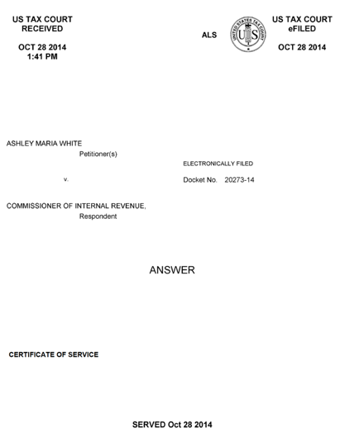
EXAMPLE – CAN’T IMPROVE DESIGN
The Court had to generate a cover sheet for incoming documents that displayed a lot of specific data – in a less than optimized way.
ORIGINAL
REDESIGNED
Notes:
Example from USTC:
The Court had a requirement: We need to generate a cover sheet that includes specific data points for all incoming documents.
But the organization was sloppy and didn’t make a lot of sense at a glance
As designers, we sought to explore how best to display this information in a format that would be easily understood by users. We iterated early on various table designs to make this info super easy to skim and get core info at a glance.
But wait, said the Court, actually... This is how it has to look
The Court operates under a set of rules and procedures, some of which go as far as to dictate the acceptable text size and page margins
Ran up against legal requirements and institutional expectations that dictated design options
Users train themselves to accept poor designs - we see this everywhere. It’s easy because it’s familiar

Slide 26
HOW TO OVERCOME
04
Tactics for change

Slide 27
LISTEN!
Let them do the talking; gain clarity on goals and tasks

Slide 28
HOW TO LISTEN
The Court users had all the information we needed to build an effective system. All we needed to do was listen.
BUILD TRUST
PROBE WITHOUT JUDGEMENT
01
Create a safe environment for users to open up
04
Listen without commentary or feedback as you learn
LEARN THE HISTORY
ALLOW FOR SELF-DISCOVERY
02
Understand the circumstances that led to current processes
05
Give people space to have their own epiphanies
REPEAT FOR CLARITY
03
Communicate in your own words to verify understanding
Notes:
Listening is the easiest way to uncover needs, but also it’s the most difficult
We got to know the court employees as people first, users second
Fostered a relationship from the start of the process through empathy and reassuring them that we weren’t there to pass judgement on them
They are the experts - we’re just here to listen and help
History - collecting different types of data - understanding the environment (physical and technological)
Make sure you understand - “mirror” what they tell you back - “So what I’m hearing is…” “Is this what you mean?”
Draw process flows or other visual aids and share them with users for validation
Reserve your judgements - don’t interject with “Oh wow, that’s an awful process”
Empathize with your users, but don’t pass judgement on their workarounds, solutions, or processes (can undermine trust)
It’s as much about them understanding as it was us
We went on the journey with the users - the more questions we asked about certain topics, you could see in their faces when they began to see inconsistencies in their old processes and became open to new solutions

Slide 29
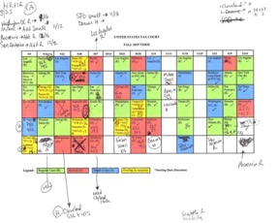
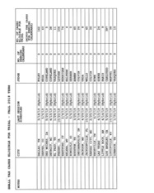
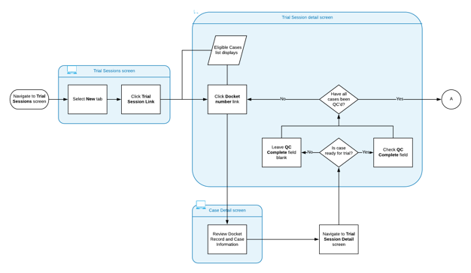
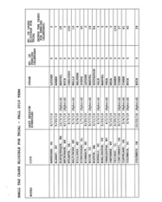
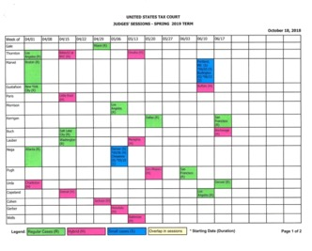
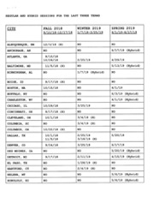
EXAMPLE – CALENDAR PROCESS
Understanding the “calendaring” process was one of the biggest challenges of this project.
LISTEN, GATHER, OBSERVE
VISUALIZE THE PROCESS
Notes:
Understanding the ‘calendaring” process was one of the biggest challenges of this project
Inputs can come in a variety of forms. Collect whatever you can.
Not just about asking interview questions, although we did ask questions, a lot of questions
Collect any artifacts that you can - we gathered a stack of charts and reports that the Court was currently using to perform this task
Visualizing helps researchers and users see things for how they are.
Visualizing does two things (and more)
Ensure that we as researchers correctly understand the current process and can communicate it back to the Court
Open up your eyes - seeing an overly complex process in a visual way can help users point out where inefficiencies lie

Slide 30
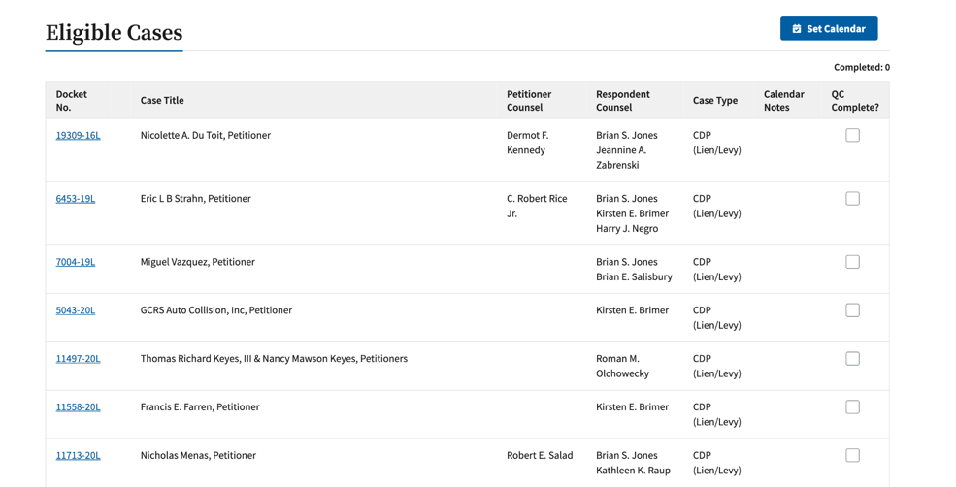
EXAMPLE – OUTCOME OF LISTENING
Through listening tactics, we were able to take a stack of reports and a process that took over two weeks to complete…and replace it with a button!
BECAME THIS
Notes:
It took a lot of effort to get to the real problem - but the payoff was ever bigger
Once we understood what really needed to be done (versus just the way they were currently doing things), we were able to take a stack of reports and a process that took over 2 weeks to complete….
And replace it with a button. (system automated all their manual work)

Slide 31
WIN USERS OVER
Build trust, gain buy-in

Slide 32
HOW TO WIN USERS OVER
You need users to feel comfortable enough to be honest with you and have them trust that you’re working in their best interests.
BE A SKEPTIC, TOO
BUILD EXCITEMENT
01
Embrace the user’s skepticism about a new system
04
Let users see the incremental improvements
EXPLAIN THE “WHY”
ENCOURAGE OWNERSHIP
02
Walk users how UX works and why we’re asking these questions
05
Help them see how their needs and ideas are incorporated into the new design
SHARE, SHARE, SHARE
03
Involve users early and often in design feedback sessions
Notes:
1) show empathy, go on the journey with them; we’re not the guides, no agenda
2) how UX works , if we don’t implement one of their ideas, we tell them why
3) Collaborative environment and process - users came to regular meetings, gave feedback and quickly see it incorporated
4) Collaboration helps build trust and excitement - let their ideas take shape
5) Share in the process with them – give credit where they helped improve ideas, show them the changes their ideas prompted

Slide 33
EXAMPLE – USER FEEDBACK
During collaboration and usability testing sessions, we repeatedly heard encouraging comments from users about the new system.
"I like the idea of having messages on my dashboard. Yeah, that works for me."
- Judge
"Once I hit that one button it's a done deal? That's cool!”
- Calendar Clerk
“With everything in one place it makes job functions a lot easier.”
- Docket Clerk

Slide 34
UNCOVER HIDDEN NEEDS
Keep probing until you get to the root causes

Slide 35
HOW TO UNCOVER HIDDEN NEEDS
You need users to feel comfortable enough to be honest with you and have them trust that you’re working in their best interests.
FIVE WHYS
GET CREATIVE
01
Keep asking “why” until you get to root causes
04
Think outside the box from how users currently work
MIXED RESEARCH METHODS
PUSH THE BOUNDARIES
02
Usability testing, 1:1 deep dives, and group discussions helped reveal the full picture
05
Don’t let existing constraints go unchallenged
REFRAME THE QUESTION
03
Users can speak more to what they need to do than how they want to do it
Notes:
Act like a toddler - keep asking “why” until you get to an “huh, I don’t know” or really figure out the root cause. This usually takes multiple sessions and can be frustrating for users who think they’ve already answered this
Explain WHY you’re asking why - use the frozen chicken analogy - find the CAT in their process
Never one and done
Held a series of interviews with all types of user roles, sometimes targeted on a feature, sometimes more open-ended and exploratory
Usability testing would be favorable, but then we conducted end-to-end testing and saw the gaps
No one user knew the entire system (silos) so we didn’t know what we didn’t know
Not just “how do you do that” but “what are you trying to accomplish”
Don’t get stuck in the same “that’s how it’s always been done” thinking
This gets you the same system, just slightly better
Be mindful if existing constraints are actually still constraints - is it a law or regulation? Is it a technical limitation because of the way the old system was built? Is it an internal process/workaround creating the barrier?

Slide 36

EXAMPLE – ROUNDTABLE USABILITY TESTING
We conducted end-to-end testing using a cooperative approach with all user groups where they could experience one another’s tasks, challenges, and needs.
PUT THINGS IN CONTEXT
Create scenarios as close to real life as possible
GAIN A HOLISTIC VIEW
The system wasn’t just siloed tasks — rather an end-to-end flow that involved many handoffs between processes
Notes:
Roundtable usability testing
Put things in context
Usability testing is almost always made-up scenarios in artificial circumstances - try to create reality as much as possible
Users passed a case to each other using real-life scenarios created by researchers and the PO
users interacted with each other through the system as they would normally, but were able to see each other’s challenges and discuss issues as they arose
Take a holistic view
Our earlier testing was successful because it was siloed
Move to a 30,000-foot view - sometimes you need to see the big picture to be able to understand the minutia
When it came to messaging, we were wrong. The users had needs they hadn’t (or couldn’t) express that became obvious when we saw everything working in context

Slide 37
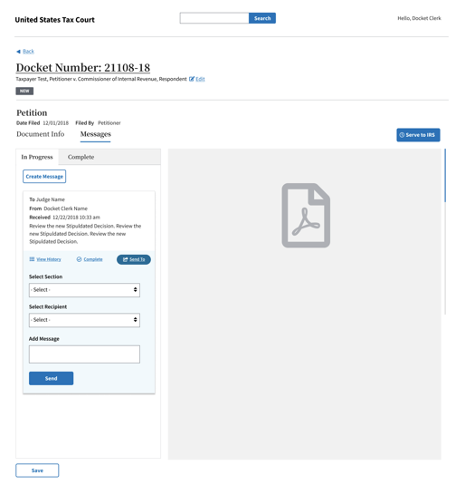
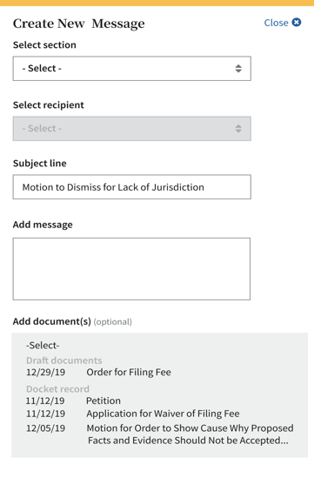
EXAMPLE – MESSAGEING & DOCUMENTS
Users kept talking about sending documents to each other — what they really needed was to send messages with or without documents attached.
WHAT THEY SAID THEY NEED
WHAT THEY REALLY NEED
Notes:
Users don’t always know what they need
Users need to be able to send documents to each other
Document-driven Messaging solution
Began with a set of assumptions around the hierarchy of information and how users would be using this functionality
Users kept talking about “sending documents to each other”
We prototyped a system where you could send documents to others and attach a message to it
Tested well in targeted usability tests for months
Turns out, users didn’t just need to send documents to each others
They needed
a way to communicate about cases (including documents but not requiring a document)
Ways to track multiple documents within the same workflow
Ability to take action within the workflow

Slide 38
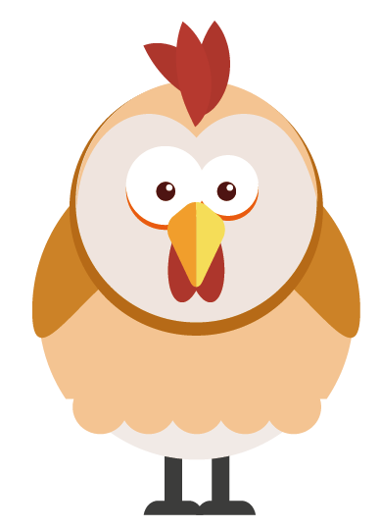
The end result
RESULT
Perfectly thawed chicken!

Slide 39

THANK YOU
Q&A

